Slide 1


Accenture Innovation Challenge
Blaze the path to new realities

Slide 2
Team name and member details
Team name | Member names | Education institute name
KBPBOYS | Vishwajeet Sanjay Kadam (Team Leader) | Karmveer Bhaurao Patil College of Engineering Satara
 | Member 2
 | Member 3
 | Member 4

Slide 3
Problem statement
Innovate for Society -
Post Harvest Management
Create a WebAPP that contains information/Stages about Innovate for Society - Post Harvest Management.
Deploy WebAPP on AWS Cloud with AWS Security and high availability.
Name- Vishwajeet Sanjay Kadam

Slide 4
Solution / your big Idea
Quality
Check
Quantity
Durability
Store
Prevent
Processing
APP Stage 1 :
Stage Description :
Check Quality : User can check their Product Quality in their nearest Quality Checking Services/Centers.
Quantity : Check and analysis the total product availability.
Durability : Check Product and suggest the time durability of product.
Store : Suggest the best storage options for mass product.
Prevent : Analyze for preventing product according to its Geographic location.
Processing : Processing for making Raw-Product to Final Product.
Preservation : Product is preserved for long duration.
Ready Product : Product is prepared for selling and packaging for market.
Market Place : Search the best nearest place for marketing and selling product.
Transportation : Suggest the best transporting option for transport product.
Final Selling : Suggest best seller on Amazon.in website.
Preservation
Ready Product
Market place
Transportation
Selling Product
TECHNOLOGY USED : Example - Natural Language Processing, Machine Learning, any other…

Slide 5
Mass Production
Storage
Preservation
APP Stage 2 :
Stage Description :
Mass Production : Utilization and suggestion for Mass-Production.
Store : How to store mass-product for long time.
Preservation : Suggest Preservation option for mass-product.
Byproduct/Alternate : Suggest best making alternative products.
Selling : Suggestion for good time and best market place.
Byproduct/
Alternative
Selling

Slide 6
Wastage
Recycling
Selling
APP Stage 3 :
Stage Description :
Waste Product : Suggest waste product market and for making alternative product.
Recycling : Suggestion for making waste product to useful product.
Selling : Suggest best recycling companies and market places.
APP Stage 4 :
Stage Description :
Total Wastage Product : Suggestion for Product Insurance, Government Policies, New Product Production idea etc.
Total Wastage

Slide 7
APP Stage 5 :
Stage Description :
- This stage is useful for those farmer which is poor and those have small quantity of farm.
- They come together and form a Group which can get help to Post-Harvest Management and get more Profit.
Forming
Group
Selling Product

Slide 8
Impact
BENEFIT TO BUSINESS & SOCIETY
Its good opportunity for Farmer to increase Crop and Profit.
Stop food wastage and wastage will be reused.
New technique and idea implemented for Crop development and Farmer’s Income.
Farmer got the biggest and trusted platform for getting more income.
Its best and easy platform for Post-Harvest Management.

Slide 9
How is the solution innovative?
Farmer gets fair value for their product.
Reduce the post-harvest losses to raise farmer income and improve food security and livelihoods for vulnerable people.
Improve the quality of farm produce.
Proper Guidance from beginning.
Enable farmers to make better decisions about crop quality and the appropriate buyer.
Suggest Fertilizers and Pesticides.
High secure WebAPP.
How its unique from other solutions in market
PATENT FILED: Yes/No

Slide 10
Testimony
No
IS THE IDEA/INNOVATION PUBLISHED EXTERNALLY AND REFERENCEABLE ? Yes/No
Video Testimony Link OR External publication Links if any

Slide 11
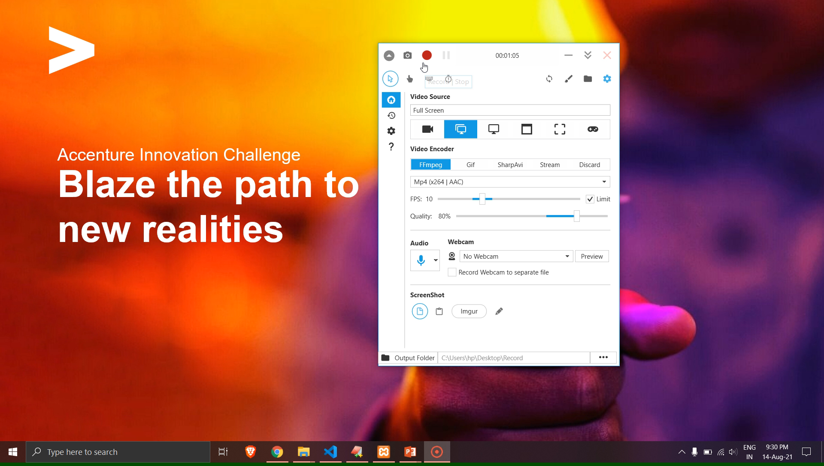
Elevator pitch video (1-2 min)
Insert the video on this slide or send it separately

Slide 12
Thank you!

